Slide 1
A Paradigm Shift in XSS-DOM Mitigation via Dynamic Content Security Policy
Under the guidance of
Dr. P. Kola Sujatha
Krishnaa S (2020506045) Jawahar A S (2020506035) Thamizharasi M (2020506102)

Slide 2
PROBLEM STATEMENT
Cross-Site Scripting (XSS) vulnerabilities persist as a major threat in web applications, jeopardizing user data and privacy. This highlights the urgent need for innovative and adaptive security measures to enhance protection for evolving web applications.

Slide 3
OBJECTIVES
Understanding Vulnerabilities: Gain insight into the nature and mechanics of Cross-Site Scripting (XSS) and DOM-based attacks.
Detection Techniques: Investigate methods (Pattern matching) for identifying XSS-DOM vulnerabilities, enabling proactive defense against potential attacks.
Preventive Strategies: Explore strategies such as input validation and Content Security Policy (CSP) to mitigate the risks of XSS-DOM attacks.
Real-world Insights: Analyze real-world cases of notable attacks to grasp the potential consequences and implications of these vulnerabilities.

Slide 4
LITERATURE SURVEY
SNo | Description | Pros and Cons
1 | JSCSP: A Novel Policy-Based XSS Defense Mechanism for Browsers * JavaScript based Content Security Policy (JSCSP) to mitigate XSS attacks. * Offers efficient algorithm to automatically generate the policy directives. * Implemented on a Chrome extension and delivers better performance compared to other XSS defense solutions. | Advantages: * Scalability: JSCSP is able to support for most browsers. * Automated generation of CSP. Disadvantages: * No detection of attack. * Only works for static pages.
2 | Prevention Of DOM Based XSS Attacks Using A White List Framework * proposes an anti-DOM XSS framework designed to protect clients by blocking malicious scripts in the HTML DOM tree source. * Effectively prevents DOM XSS attacks, and a prototype tool has been developed to validate its effectiveness. | Advantages: * White list frameworks have a lower false positive rate * Provide granular control over the sources and types of input that are allowed, allowing for precise mitigation of specific attack vectors. Disadvantages: * Maintaining a white list can be challenging and time-consuming. * They only allow what is explicitly permitted on the list, which can limit the flexibility of web applications.

Slide 5
LITERATURE SURVEY
SNo | Description | Pros and Cons
3 | XSnare: Application-specific client-side cross-site scripting protection * Firefox extension that offers client-side protection against XSS attacks. * Preemptively blocks XSS attacks by leveraging prior knowledge of web app’s HTML templates and rich DOM context. * Utilizes an exploit database, crafted from recorded CVEs. | Advantages: * XSnare is designed to be application-specific. * Offers preemptive protection to users. Disadvantages: * Maintaining the exploit database with up-to-date CVE information * XSnare is implemented as a Firefox extension, hence it may not be compatible with other web browsers.
4 | A XSS Attack Detection Method Based on Subsequence Matching Algorithm * Detection technique using a subsequence matching algorithm (b/w user input and generated data). * sets a threshold to limit the length of the common subsequence and blocks XSS attacks if the threshold is exceeded | Advantages: * Proposes a new method for detecting XSS vulnerabilities using a subsequence matching algorithm. * Incorporates a threshold to limit the length of common substrings. Disadvantages: * The proposed method may not be scalable for large-scale web applications. * may not be compatible with all web application, frameworks and technologies.

Slide 6
LITERATURE SURVEY
SNo | Description | Pros and Cons
5 | A comparative analysis of Cross Site Scripting (XSS) detecting and defensive techniques * This paper highlights the critical threat of XSS attacks, which can compromise web application security by injecting malicious JavaScript code into either the client-side or server-side. * The study explores XSS attack taxonomy, incidence, and mechanisms for detection and prevention, emphasizing the imperative need for safeguarding against this vulnerability. | Advantages: * The hybrid analysis approach in this framework combines static analysis and dynamic symbolic execution, providing a more precise identification of DOM-sourced XSS vulnerabilities. * Incorporating shadow DOM in the dynamic analysis phase enhances the framework's accuracy. Disadvantages: * Implementing a framework with multiple phases of analysis, including static and dynamic components, demands a complex setup. * The dynamic symbolic execution phase, particularly when using shadow DOM, can be resource-intensive.

Slide 7
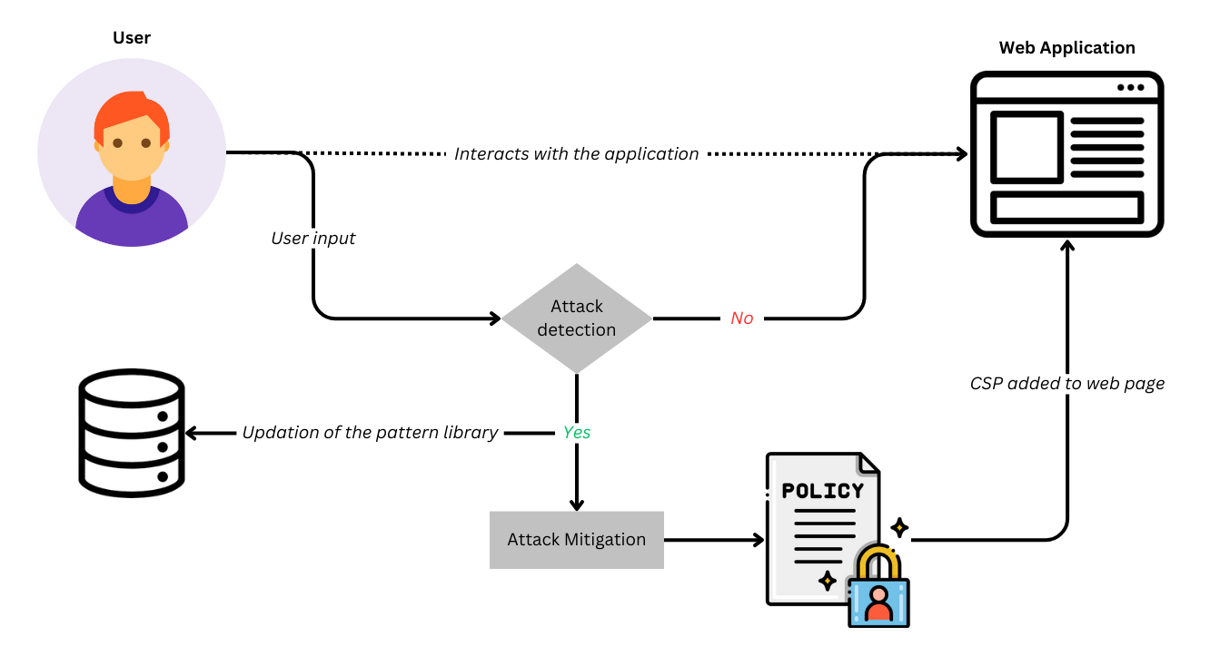
ARCHITECTURE DIAGRAM

Slide 8
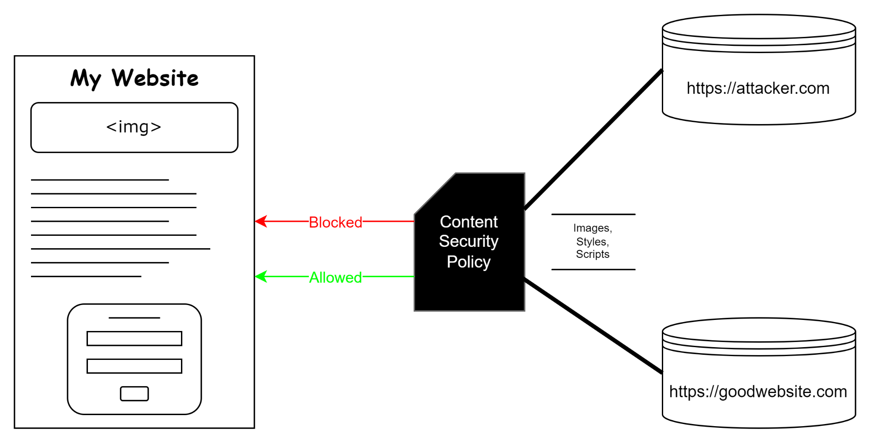
ARCHITECTURE DIAGRAM

Slide 9
NOVELTY
Traditionally XSS DOM attacks are detected using manual techniques. Source code of the application is inspected for certain sources and sinks where there is a possibility of an XSS DOM attack.
Implemented pattern matching techniques in our application to detect the vulnerable scripts that have been injected.
Proposed a dynamic pattern updation algorithm where taint analysis is performed and a vulnerable input is added to the pattern library.

Slide 10
ALGORITHM
Input
User input from various sources in the web application.
Output
Detection of potential malicious scripts.
Application of Content Security Policy for mitigation.
Steps
1. Initialization:
1.1 Initialize the dynamic pattern library with predefined patterns.
2. User Input Processing:
2.1 Receive user input from different sources in the web application.

Slide 11
ALGORITHM
3. Dynamic Pattern Matching:
3.1 Iterate through the dynamic pattern library.
3.2 Check if the user input matches any predefined patterns.
3.3 If a match is found:
3.3.1 Log the potential malicious script.
3.3.2 Optionally, take further actions (e.g., alerting, blocking).
4. Taint Analysis
4.1 Optionally perform taint analysis on user input to detect potential vulnerabilities.
4.2 Identify and log any tainted input that may lead to script execution.

Slide 12
ALGORITHM
5. Dynamic Pattern Update:
5.1 Check if the user input is not in the dynamic pattern library.
5.2 If not:
5.2.1 Add the new input to the dynamic pattern library.
5.3 Log the addition of the new pattern.
6. Content Security Policy Implementation:
6.1 Apply the Content Security Policy rules to the web application.
6.2 Restrict the execution of JavaScript and CSS based on the defined policy.
6.3 Allowlist external scripts and stylesheets from trusted sources.

Slide 13
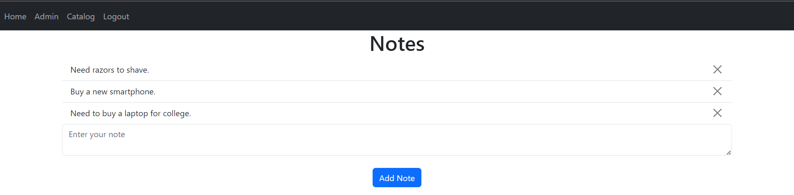
IMPLEMENTATION
Created a E-Commerce Website to test XSS-DOM Web attack
add notes like shopping list in Amazon

Slide 14
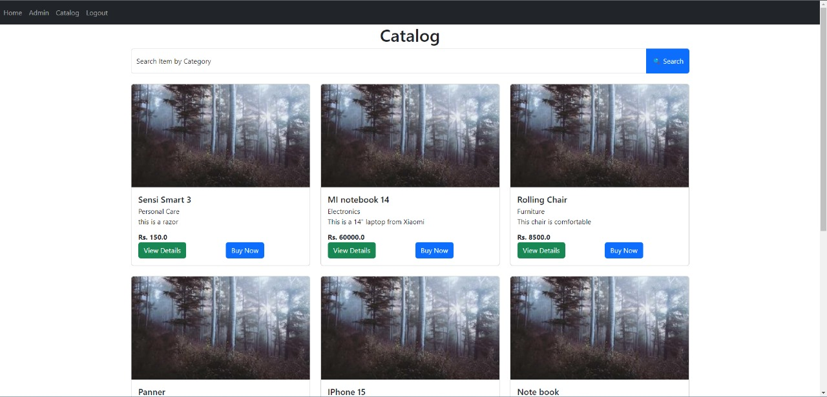
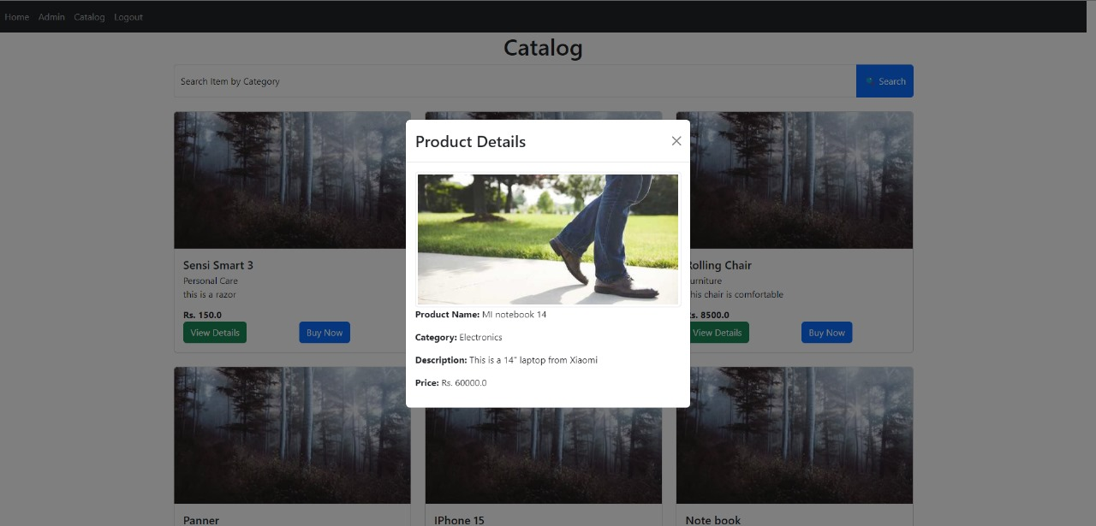
IMPLEMENTATION
feed option where script could be injected to attack the page.

Slide 15
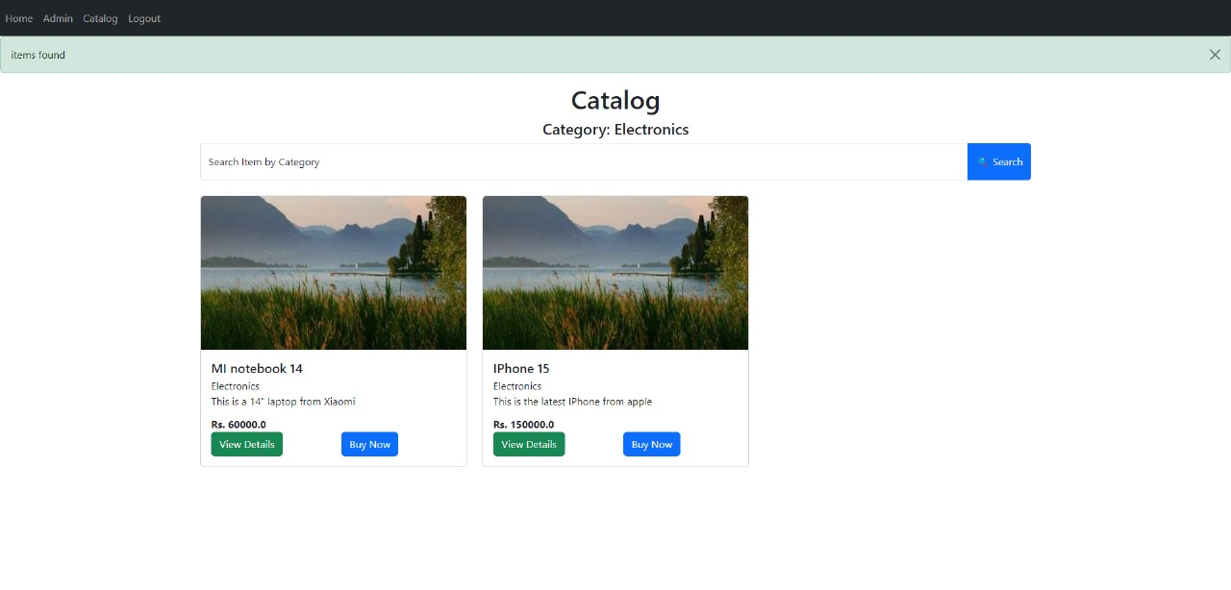
IMPLEMENTATION
Search by category page

Slide 16
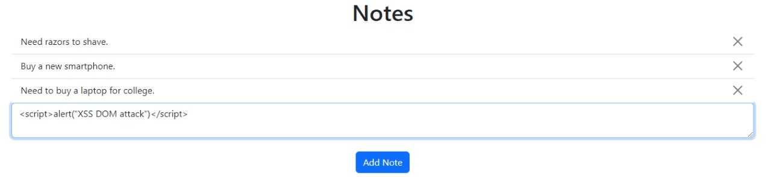
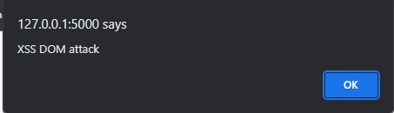
IMPLEMENTATION - DETECTION
Detection of XSS – DOM attack
In notes page, by feeding the script through the input bar.

Slide 17

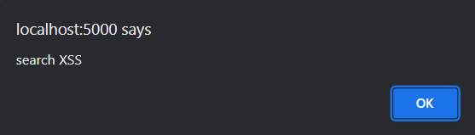
IMPLEMENTATION
Detection of XSS – DOM attack
In User page , by feeding the script through the category search bar. So that will lead to the missing information in the result page.

Slide 18

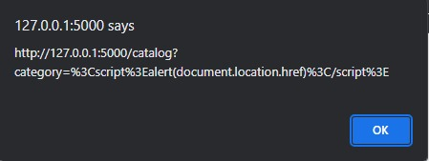
IMPLEMENTATION
Detection of XSS – DOM attack
By feeding through the URL.

Slide 19
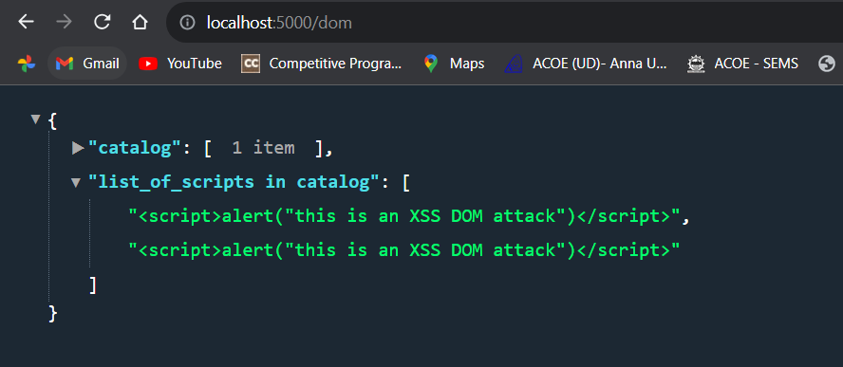
IMPLEMENTATION
Detection of XSS – DOM attack using Regular expression and pattern matching

Slide 20
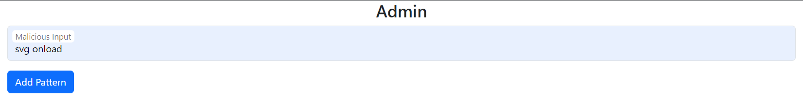
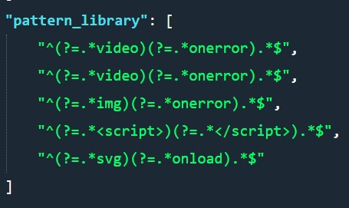
IMPLEMENTATION
Detection of XSS – Adding a new pattern to the pattern library

Slide 21
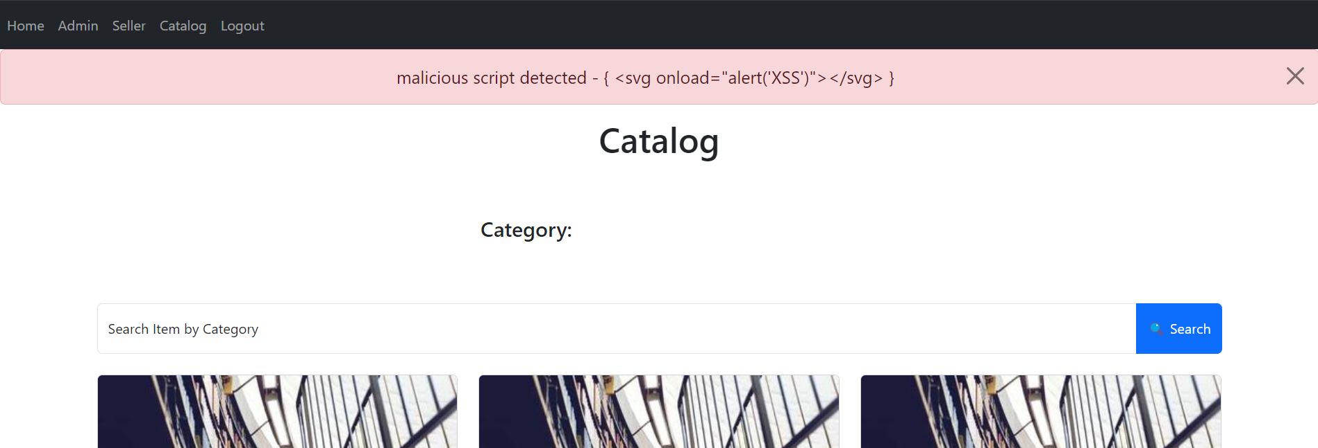
IMPLEMENTATION
Detection of XSS – Malicious script detected

Slide 22
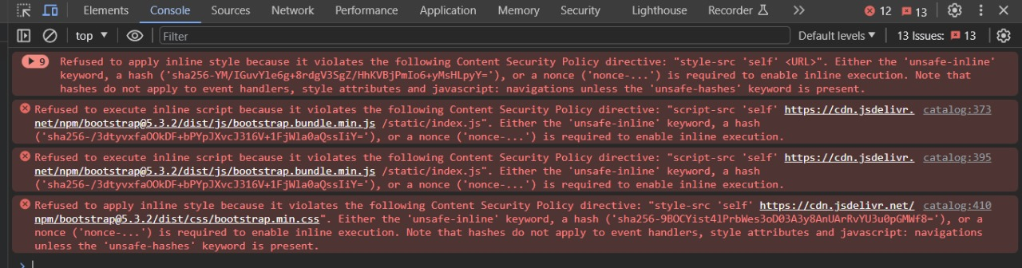
IMPLEMENTATION - MITIGATION
Implemented CSP Policy to Prevent XSS DOM Attacks
Illustration of warnings raised after prevention of the attacks.

Slide 23
EVALUATION METRICS
List of types of scripts detected
<script>alert('XSS')</script>
<img src="x" onerror="alert('XSS')">
<a href="javascript:alert('XSS')">Click me</a>
<input type="text" value="x" onfocus="alert('XSS')">
<svg onload="alert('XSS')"></svg>
<div onmouseover="alert('XSS')">Hover me</div>
<iframe src="javascript:alert('XSS')"></iframe>

Slide 24
BENEFITS
Uncompromised User Confidence: Mitigating XSS-DOM vulnerabilities fosters user trust in application's security and reliability.
Preserved Data Integrity: By neutralizing these threats, you maintain the integrity of user data, preventing unauthorized access and tampering.
Enhanced Brand Reputation: A secure application reflects positively on a brand, positioning the owner as a responsible and security-conscious provider.
Reduced Legal and Financial Risk: Preventing attacks helps you avoid potential legal liabilities and financial losses that can arise from data breaches or compromised user information.

Slide 25
CONTRIBUTION
Krishnaa S | Developed admin and catalog pages Configured SQLite database Implemented backend logic with Flask Integrated attack detection using regex Implemented mitigation via CSP
Jawahar A S | Designed front-end of Notes page Performed taint analysis Simulated various XSS attacks using malicious scripts
Thamizharasi M | Designed front-end of Login and Sign-up page Performed taint analysis Added new patterns to pattern library

Slide 26
THANK YOU

Slide 27
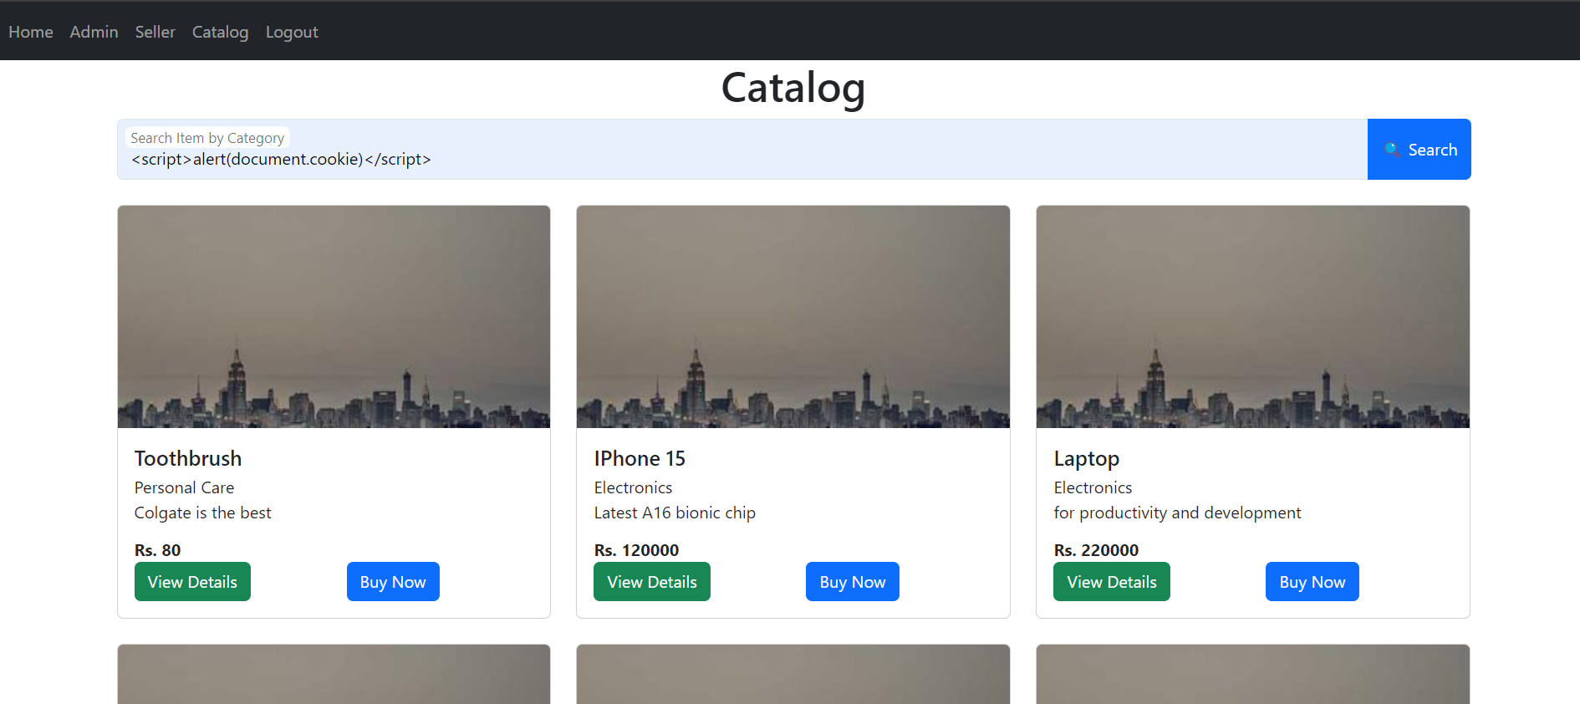
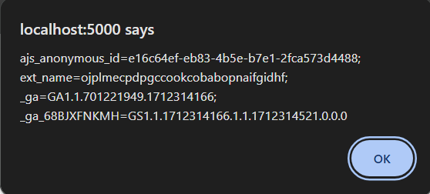

Slide 28
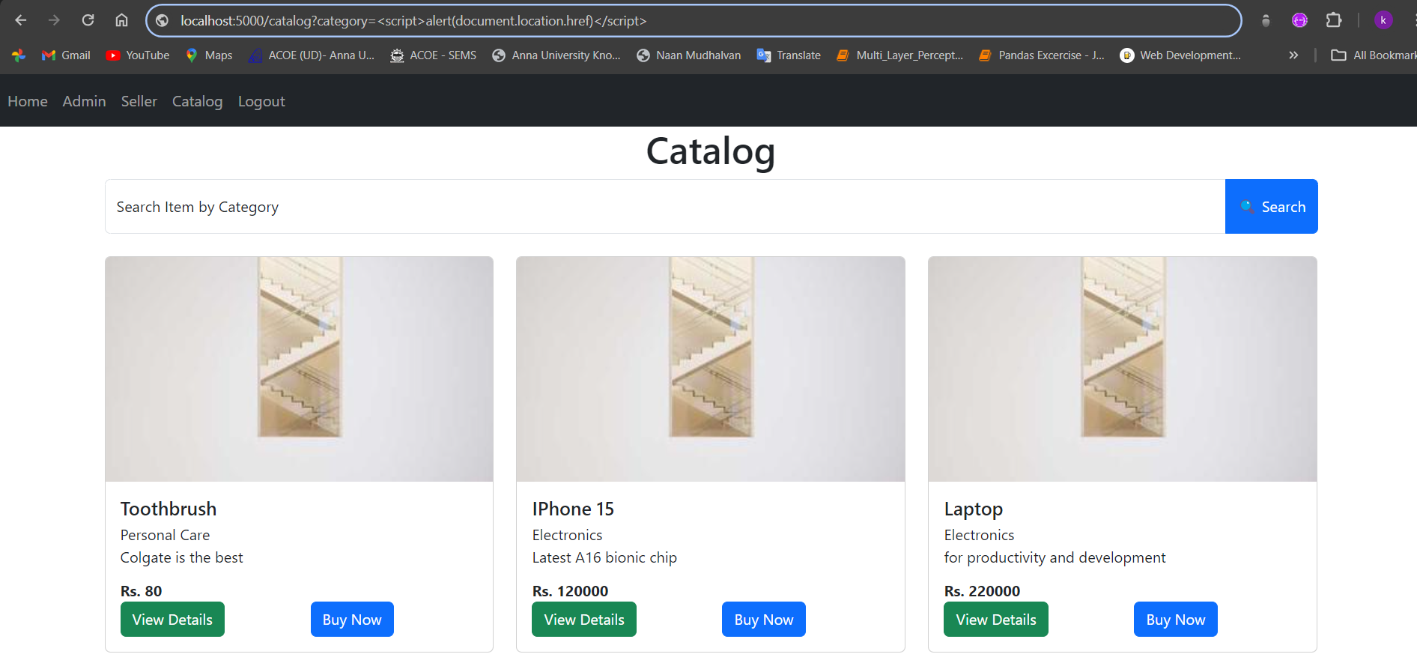
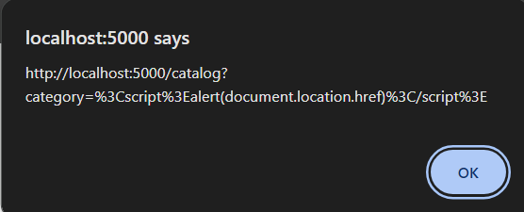

Slide 29
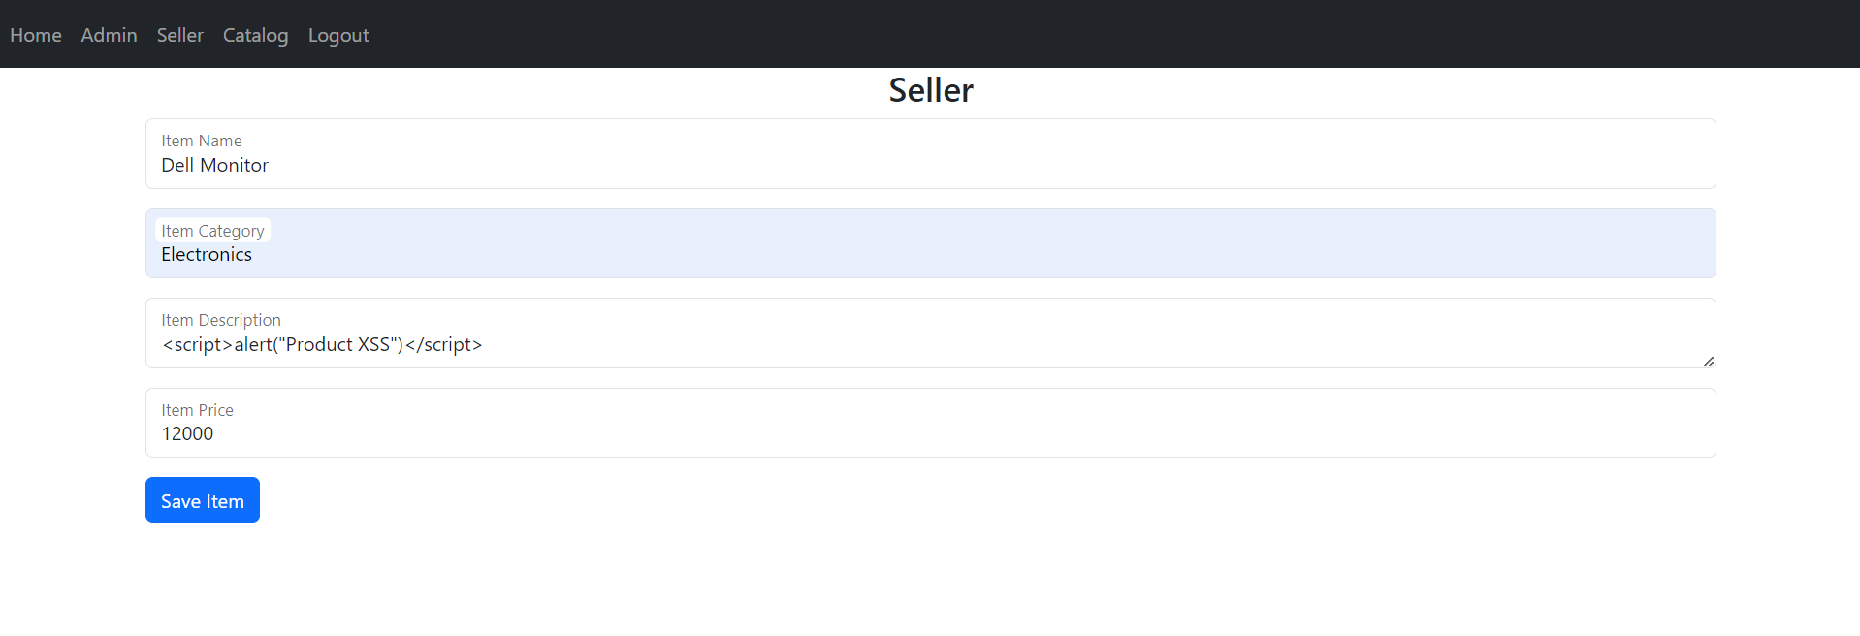
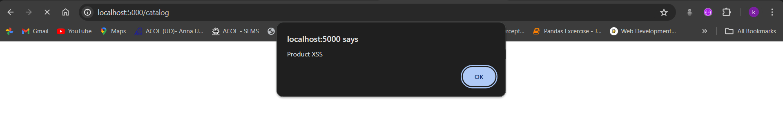
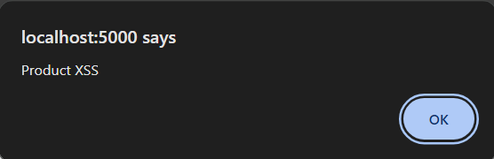

Slide 30
